Slide 2
Why to do a lesson plan
Improve the lessons:
To Predict what it could happen
What hitches could occur
How to motivate the students in the right way at each stage

Slide 3
Making an effective lesson plan
Takes time, diligence, and an understanding of the students
The goal is to motivate the students to make them learn what you planned
When you plan at the best, it is the KEY to classroom success
Notes:
3

Slide 4
1. Know your objective
At the beginning of every lesson pla , write your lesson goal at the top. It should be incredibly simple.
Something like, "Students will be able to identify different numbers from 1 to 10, moving up and down ,."
Basically, it's what the students should know or do at the end of the lesson! If you want you can add the way how they might do this (in our case it is a game).

Slide 5
Abilities
A - Consider Pre-requisites:
In teaching it is important to know what the students already learnt and what you need to implement before you start the lesson.
Example: if you want your students learn how to add numbers, you have FIRST to verify if they know the numbers.
In addition, you have to be sure until which number they know .
Only when you are sure about that, you can start with your lesson plan.

Slide 6
Abilities
B - Keep in mind, you should know the Bloom’s Taxonomy:
The most relevant aspect on the theoretical level of Bloom's taxonomy, is that
learning is conceived as a sequential and linear process that proceeds through a series of well-defined phases,
where one is a condition to have access to the next.
On a practical level this translates into a teaching strategy that proceeds from the simple to the complex , so the objectives related to the higher skills and competences is reserved to later phases of the training and development of the student.

Slide 7
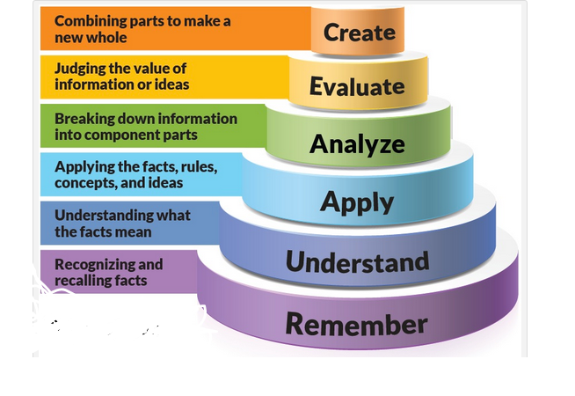
Actually we have a revised B. Taxonomy, made by one of his students: It has been made to adapt it to the needs of teachers and students of the 21st century
Notes:
7

Slide 9
Now the question is:
How math games compendium and guidebook can help?
Open the book at pag. 10 and have a look to the synopsis.

Slide 10
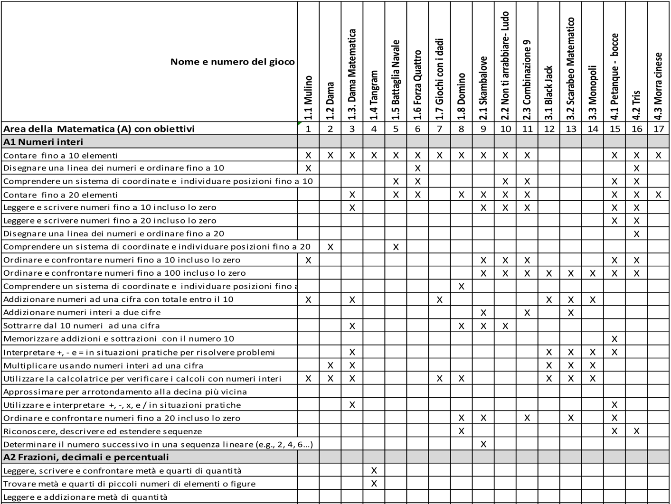
Games
Objectives

Slide 11
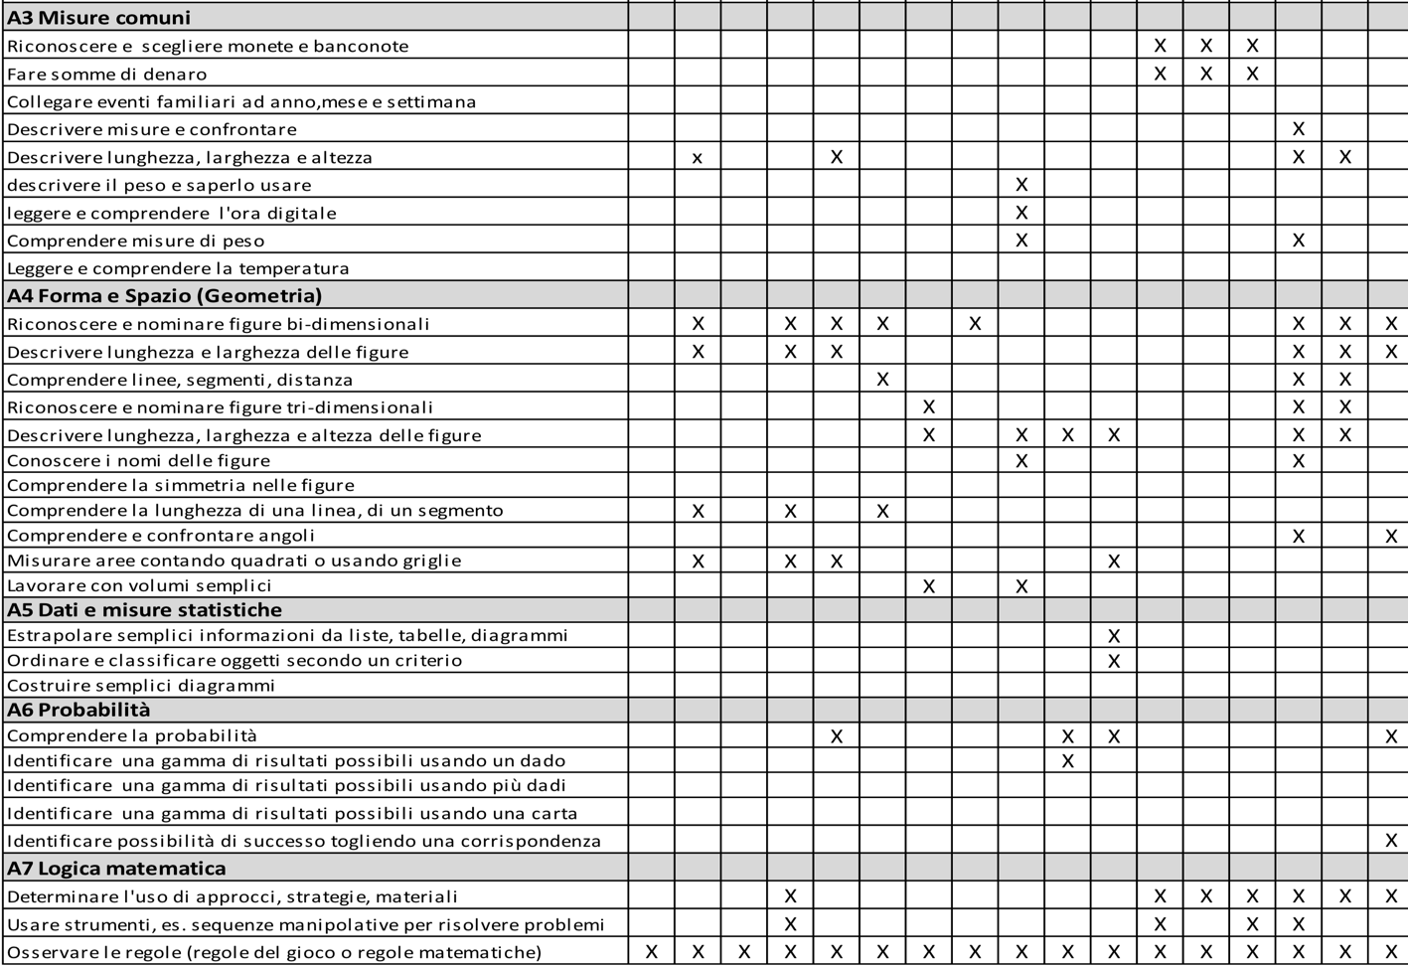

Slide 12
2. Choice of the game
For the choice we have to focus on the students attitudes
Are the students oriented towards a special kind of game?
We have different games, so before the choice we have to know his/her attitude:
Does he/she like to play alone?
Does he/she like playing with an opponent?
Does he/she like to play in the group?
Which games does he/she like to play?

Slide 13
What is their learning style?
Remember that in a class we can have
students with SEN
those who are struggling
those who are gifted

Slide 14
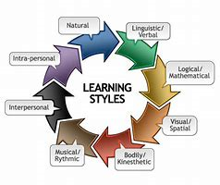
4. Address a variety of learning styles
Every student learn differently.
Some need to see the info,
some need to hear it,
others need to literally get their hands on it.

Slide 15
Actually the compendium provides several kind of games
Pure gambling (eg dice, Dominoes)
Pure brain games (for example, four in a row, chess, mill, lady)
Combined brain and luck games (eg, 17 and 4, Monopoly)
Movement games (for example, seven-step dance, rebounding game)
Motorized games (eg Mikado, game with wire)
Puzzle
Once we have linked the students and the objectives with the more suitable game we need to…

Slide 16
3. Write an overview of the lesson
The overview section includes an introduction to the activities
We can say that it is easier to have attention or motivation when we are playing games rather than in a classical math lesson. That’s why we are using and testing this methodology. For instance, in a math class, to understand that any number multiplied or divided by 0 is always 0 is very difficult.

Slide 17
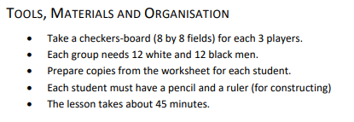
4. Plan your timeline
We have to break the plan of the lesson in more steps. The number of steps depends on the time we have. In the compendium we can see that in games explanation time is specified.

Slide 18
Usually a timeline is divided into 4/5 steps, for example:
5’ - Warm up. Inform the students they are going to play a game. We can explain briefly the game and curiosity about it, or we can use other tools, to inspire motivation and student's attention.
10’ - Present information: explanation of the game and its rules . They have to be clear, simple, synthetic. Thus, the teacher has to be well prepared→ read the game in the compendium and play it before. Distribution of materials.
5’ - Guided and freer practice. Questions and other explanation about the game/games. Start to play .At the beginning the teachers is a tutor, students then can play alone.

Slide 19
15 - Free practice.
10’ - Self-evaluation: reflect on the adopted strategies, individuate their own point of strength or weakness. Students should have a clear understanding of the main concept of the lesson and how they can apply the concept to future situations.
OR
10’ – Assignment and formal evaluation: the guidebook provides some example of sheets to be used for assignment but you can also produce by yourself to evaluate .
Conclusion: dismiss class

Slide 20
Some students will do well
on their own,
in pairs,
in big groups.
When we let them interact and build off each other, we're doing our job.
We should allow opportunities for all types of interactions.

Slide 22
AN EXAMPLE OF LESSON PLAN FORM

Slide 23
Thank you

